Slide 1


9 July 2025
Annual General Meeting
Perth Convention & Exhibition Centre
9 July 2025

Slide 2
Acknowledgement of Country
We acknowledge the traditional owners and custodians of the lands where our HERDSA members are located and pay respects to their elders, past, present, and emerging.

Slide 3
Agenda
Welcome
Attendance and Apologies
Minutes of the previous meeting (for adoption)
President’s Report and Activities
Treasurer’s and Auditor’s Reports
Recommendations for ratification 2025-2026 (Executive Members, Budget, Auditor, 2024-2025 accounts)
Other business
Meeting Closure

Slide 4
HERDSA
President’s Report and Activities
Prof Kogi Naidoo
Perth Convention and Exhibition Centre

Slide 5

HERDSA Values
Quality
Connection
Our activities are informed by and contribute to
contemporary evidence-based practice
to enhance the learning, teaching,
and research capabilities of our
members and their
institutions.
We provide opportunities for
members to engage in positive,
collaborative, scholarly interactions
and created conditions conducive
to members experiencing a sense
of belonging.
Integrity
Inclusion
We provide a relational and
Scholarly space in which members
are invited to respectfully question,
challenge an be informed by a
diversity of opinions and
perspectives. We are committed to
providing access to opportunities
and resources to support all
our members.
We uphold and expect honesty,
openness, respect, and trust
in members’ interactions
with one another
and the society.
Inquiry
We encourage and support our members to systematically investigate higher education issues leading to scholarly
solutions in practice and policy.

Slide 6
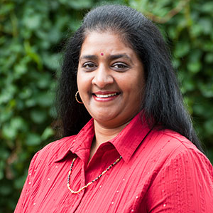
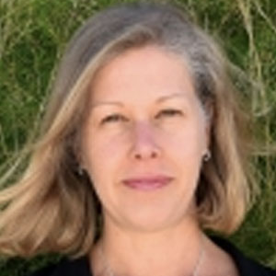
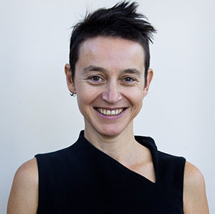

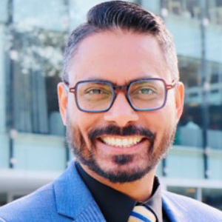
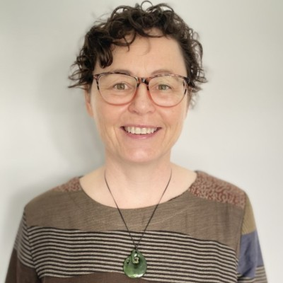
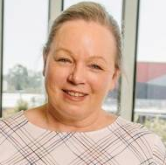
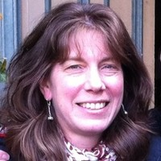
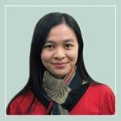
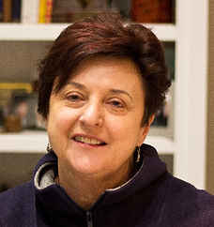
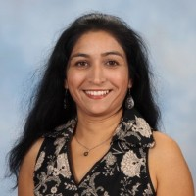
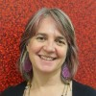
HERDSA Executive (2023-2025)
Prof Kogi Naidoo
Prof Katrina Strampel
Prof Christy Collis
A/Prof Jay Cohen
Prof Raj Shekhawat
A/Prof Eva Heinrich
President
Vice-President & Treasurer
President Elect
Treasurer (2024)
Awards and Grants
Publications-ASHRE
A/Prof Alice Brown
Prof Julia Choate
A/Prof Kwong Nui Sim
Dr Lee Partridge
Dr Manisha Thakkar
Dr Shannon Johnston
Professional Learning
Networks
Professional Learning
Fellowships: Prof Learning
(co-opted)
Communications (co-opted)
HERDSA2025 Conference
Convenor

Slide 7
HERDSA Officers/Other Positions
Dr Cally Guerin and
Dr Jisun Jung
Professor Denise Chalmers
Dr Daniel Andrews
Dr Peter Kandlbinder
A/Professor Eva Heinrich
Dr Lee Partridge
Dr Dongmei Li
Co-Executive Editor Higher Education Research & Development (HERD)
HERDSA Guides Series Editor
HERDSA Connect Blog Editor
HERDSA Weekly Notices
Advancing Scholarship and Research in Higher Education Journal (ASRHE)
HERDSA Fellowships
Talking about Teaching and Learning (TATAL)
Dr Shannon Johnston
2025 Conference Convenor
Jennifer Ungaro
HERDSA Administration Manager

Slide 8
2025 Conference Organising Committee
Our thanks to:
Shannon Johnston Convenor
Kogi Naidoo HERDSA President and Conference Liaison Officer
Tania Leach Program Co Chair
Ruth Wallace Program Co Chair
Malcolm Burt & Fiona Tang Virtual Co Chairs
Manisha Thakkar Communications Lead, HERDSA Executive
Uma Jogulu Finance Chair
Jun Chih & Anna Golab Workshop Chairs
Mollie Dollinger Keynote Chair
Rebecca Russell Social Chair
Ashleigh Prosser Sponsor and Exhibition Chair
Kathie Ardzejewska WA Communications Lead
Expert Events Conference Organiser s

Slide 9

2024-25 HERDSA Highlights
Highlights
HERDSA Strategic Plan 2023-2025 + HERDSA Values + 5-year plan
Strategic Projects: HERDSA Website, SOTL Modules Review, HERDSA Technology upgrade (now using Microsoft 365 Suite)
President-Elect – Prof Christy Collis (2024-2025)
Election of Executive members (2025-2027) – April 2025 (for ratification)
HERDSA Fellowships – 2025 17 new Fellowships awarded
HERDSA Conference Travel Grants, Awards and Prizes – 2025
HERDSA Grants Scheme (2025) - 6 awards
HERD Best Paper and Reviewer Awards (2025)
HERDSA Connect Blog Editor appointed in December 2024
HERDSA TATAL: Dr Mei Li appointed as TATAL Officer
HERDSA Life Membership Award 2025 – Dr Lee Partridge Professor Kogi Naidoo
MACS 2024-2025 - Mentoring & Coaching Support Program (new)
2024 & 2025 Conferences – Adelaide & Perth
HERDSA Group Memberships (12 Group memberships)
(July 2024 – July 2025)

Slide 10

HERDSA Awards and Grants Portfolio
HERDSA Awards and Grants Portfolio
Research Grants: (LEAD) Julia Choate & Raj Shekhawat
Conference Grants: Lee Partridge
Roger Landbeck Professional Development Fund (RLPDF): Eva Heinrich
2025 Research Grants
  6 grants of up to $5500 each
2025 Conference Awards
  6 student awards @ $1500
  10 early career awards @ $1500
  5 Taylor and Francis awards @ $500
RLPDF awarded to Aparna Datey

Slide 11

Professional Learning Portfolio
SOTL Modules and New Scholars
Fellowships
Mentoring and Coaching Support (MACS)
Kwong Nui Sim Portfolio Lead
Lee Partridge Fellowships
Officer
Alice Brown SOTL Modules
and New Scholars
Dongmei Li TATAL Officer
Kogi Naidoo Mentoring and
Coaching Support
(MACS)
2025 17 Fellowships
2024 8 Fellowships
Update:
73 HERDSA Fellows
79 Associate Fellows
16 Assessors on the Board of Assessors
Inaugural program 2023
MACS 2024
Successful with 15 HERDSA Members participating
MACS 2025 (EOIs in July 2025)
SOTL Modules and New Scholars
TATAL Group
Pre-Conference workshop
New TATAL workbook to be released 2025
TATAL Webinar
Facilitators team for Singapore Conference
Available to all members
SOTL Modules being revised
Modules available at several HE institutions

Slide 12

HERDSA Networks Portfolio
Networks Portfolio
Special Interest Groups (SIGs)
Responsible for:
HERDSA Webinar series
Nine branches (branch reports available)
Reviewing event management and promotion
Liaison with other Societies
  Current: ICED, ASCILITE, CAULLT, ACEN, ACUR, HEDx – e.g. shared publicity, events, Awards sponsorships
International Academics
linda.ng@unisq.edu.au
Assessment Quality thomas.wanner@adelaide.edu.au
Academic Development
erik.brogt@canterbury.ac.nz
Health Sciences skusljic@unimelb.edu.au
Humanities Arts and Social Sciences (HASS) - nira.rahman@unimelb.edu.au
Online Engagement Alice.Brown@unisq.edu.au
Scholarship of Teaching and Learning (SoTL) trisha.poole@unisq.edu.au
Student Wellbeing and Belonging
c.maloney@unsw.edu.au
New SIG enquiries Alice.Brown@unisq.edu.au
Julia Choate: Portfolio Lead
Julia Choate: Branches
Kwong Nui Sim: HERDSA Events
Alice Brown: Special Interest Groups
Notes:
Networks Portfolio

Slide 13

Publications Portfolio - HERD
HERD Journal
Submissions continue to increase
  2017 – 506 submissions
  2023 – 1075 (871 original subs/204 revised) submissions
  2024 – 1459 (1212 original subs/247 revised - 35% increase)
  Now publishing 8 issues/year
  2 Special Issues in 2025 and 2 scheduled for 2026
Annual acceptance rate remains at around 10%
HERD maintained Q1 status and Impact Factor is up from 2.6 to 2.9
Readers – around 759,000 downloads in 2024
Already 205,420 downloads in Q1 of 2025
Average turnaround for peer review of articles for first half of 2025 is down from 31 days (2024), to 29.5 days
Average turnaround for our reviewers continues to be 21 days on a review, well within our given 30 days
HERD Editorial Team (2024-2025)
Joint Executive Editors: Cally Guerin (2024-2025) & Jisun Jung (2024-2025) Co-Editors: Rob Wass, Guy Curtis, Neal Dreamson
Special Issues Editor: Stphen Marshall
Managing Editor: Emily Giles
Social Media Editor: Stuart Hughes

Slide 14
Publications Portfolio - ASRHE
Advancing Scholarship & Research in Higher Education (ASRHE) Journal
ASHRE is open source, published under Creative Commons licence
2024 Issue 1 published
Wide readership (e.g., from 133 countries, 433 average views for 2020 articles)
Executive Editor: Eva Heinrich
Editors: Geoff Hill, Jo-Anne Kelder,
Michelle Picard
Managing Editor: Heather Thomas

Slide 15
Publications Portfolio - HERDSA Guides
HERDSA Guides
Series Editor:
Professor Denise Chalmers
New HERDSA Guide released in 2023:
  Enhancing Online Engagement in Higher Education – A Brown, J Lawrence, P Redmond, J Cohen, S M Foote and C Stone
23 Guides Available in print and ePublications
ePublications (Kortext)
Purchase Printed or e-Books through the HERDSA website

Slide 16
Publications Portfolio- HERDSA Connect Blog
HERDSA Connect Blog
Blog Editor: Daniel Andrews
Published on HERDSA Website
HERDSA Connect Blog: now established and covers a range of activities and interests

Slide 17
Group Membership (FYI)
HERDSA Group Membership
Group Membership 1 year | 10 members $1435 ($1650) | 20 Members $2870 ($3300) | 30 Members $4260 ($4950)
Other Benefits | 1 free pre-conference workshop 1 free Associate Fellowship application ($110) | 2 free pre-conference workshops 2 free Associate Fellowship applications ($220) | 3 free pre-conference workshops 3 free Associate Fellowship applications ($330)

Slide 18
HERDSA Upcoming Conferences
(for noting)
HERDSA Conferences
2025 Perth, WA 8-10 July 2025
2026 Singapore 7-9 July 2026
2027 TBC EOI going out in July
2028 TBC EOI going out in July
Conference Liasion: Prof Kogi Naidoo

Slide 19
HERDSA 2027 & 2028
Who would like to convene HERDSA2027 and HERDSA 2028?
Can be run by a branch or any group of HERDSA members
Very strong support provided by events manager Expert Events
EOI due to office@herdsa.org.au 30 Sept 2025
branch or by any group of HERDSA members
Very strong support by events manager Expert Events
EOI due to office@herdsa.org.au 30 Sept 2025

Slide 20
HERDSA AGM 9 July 2025
Perth Convention and Exhibition Centre
Treasurer’s Report
Prof Katrina Strampel

Slide 21

Overview of Accounts
Overview of Accounts
HERDSA Office is located in Sydney, Australia for the day-to-day operations of the Society, and branch administration of Australian accounts
HERDSA NZ Branch
The HERDSA branch account in NZ is operated by the NZ Branch Treasurer
HERDSA Hong Kong Branch
The HERDSA branch account in HK is operated by the HK Branch Treasurer

Slide 22
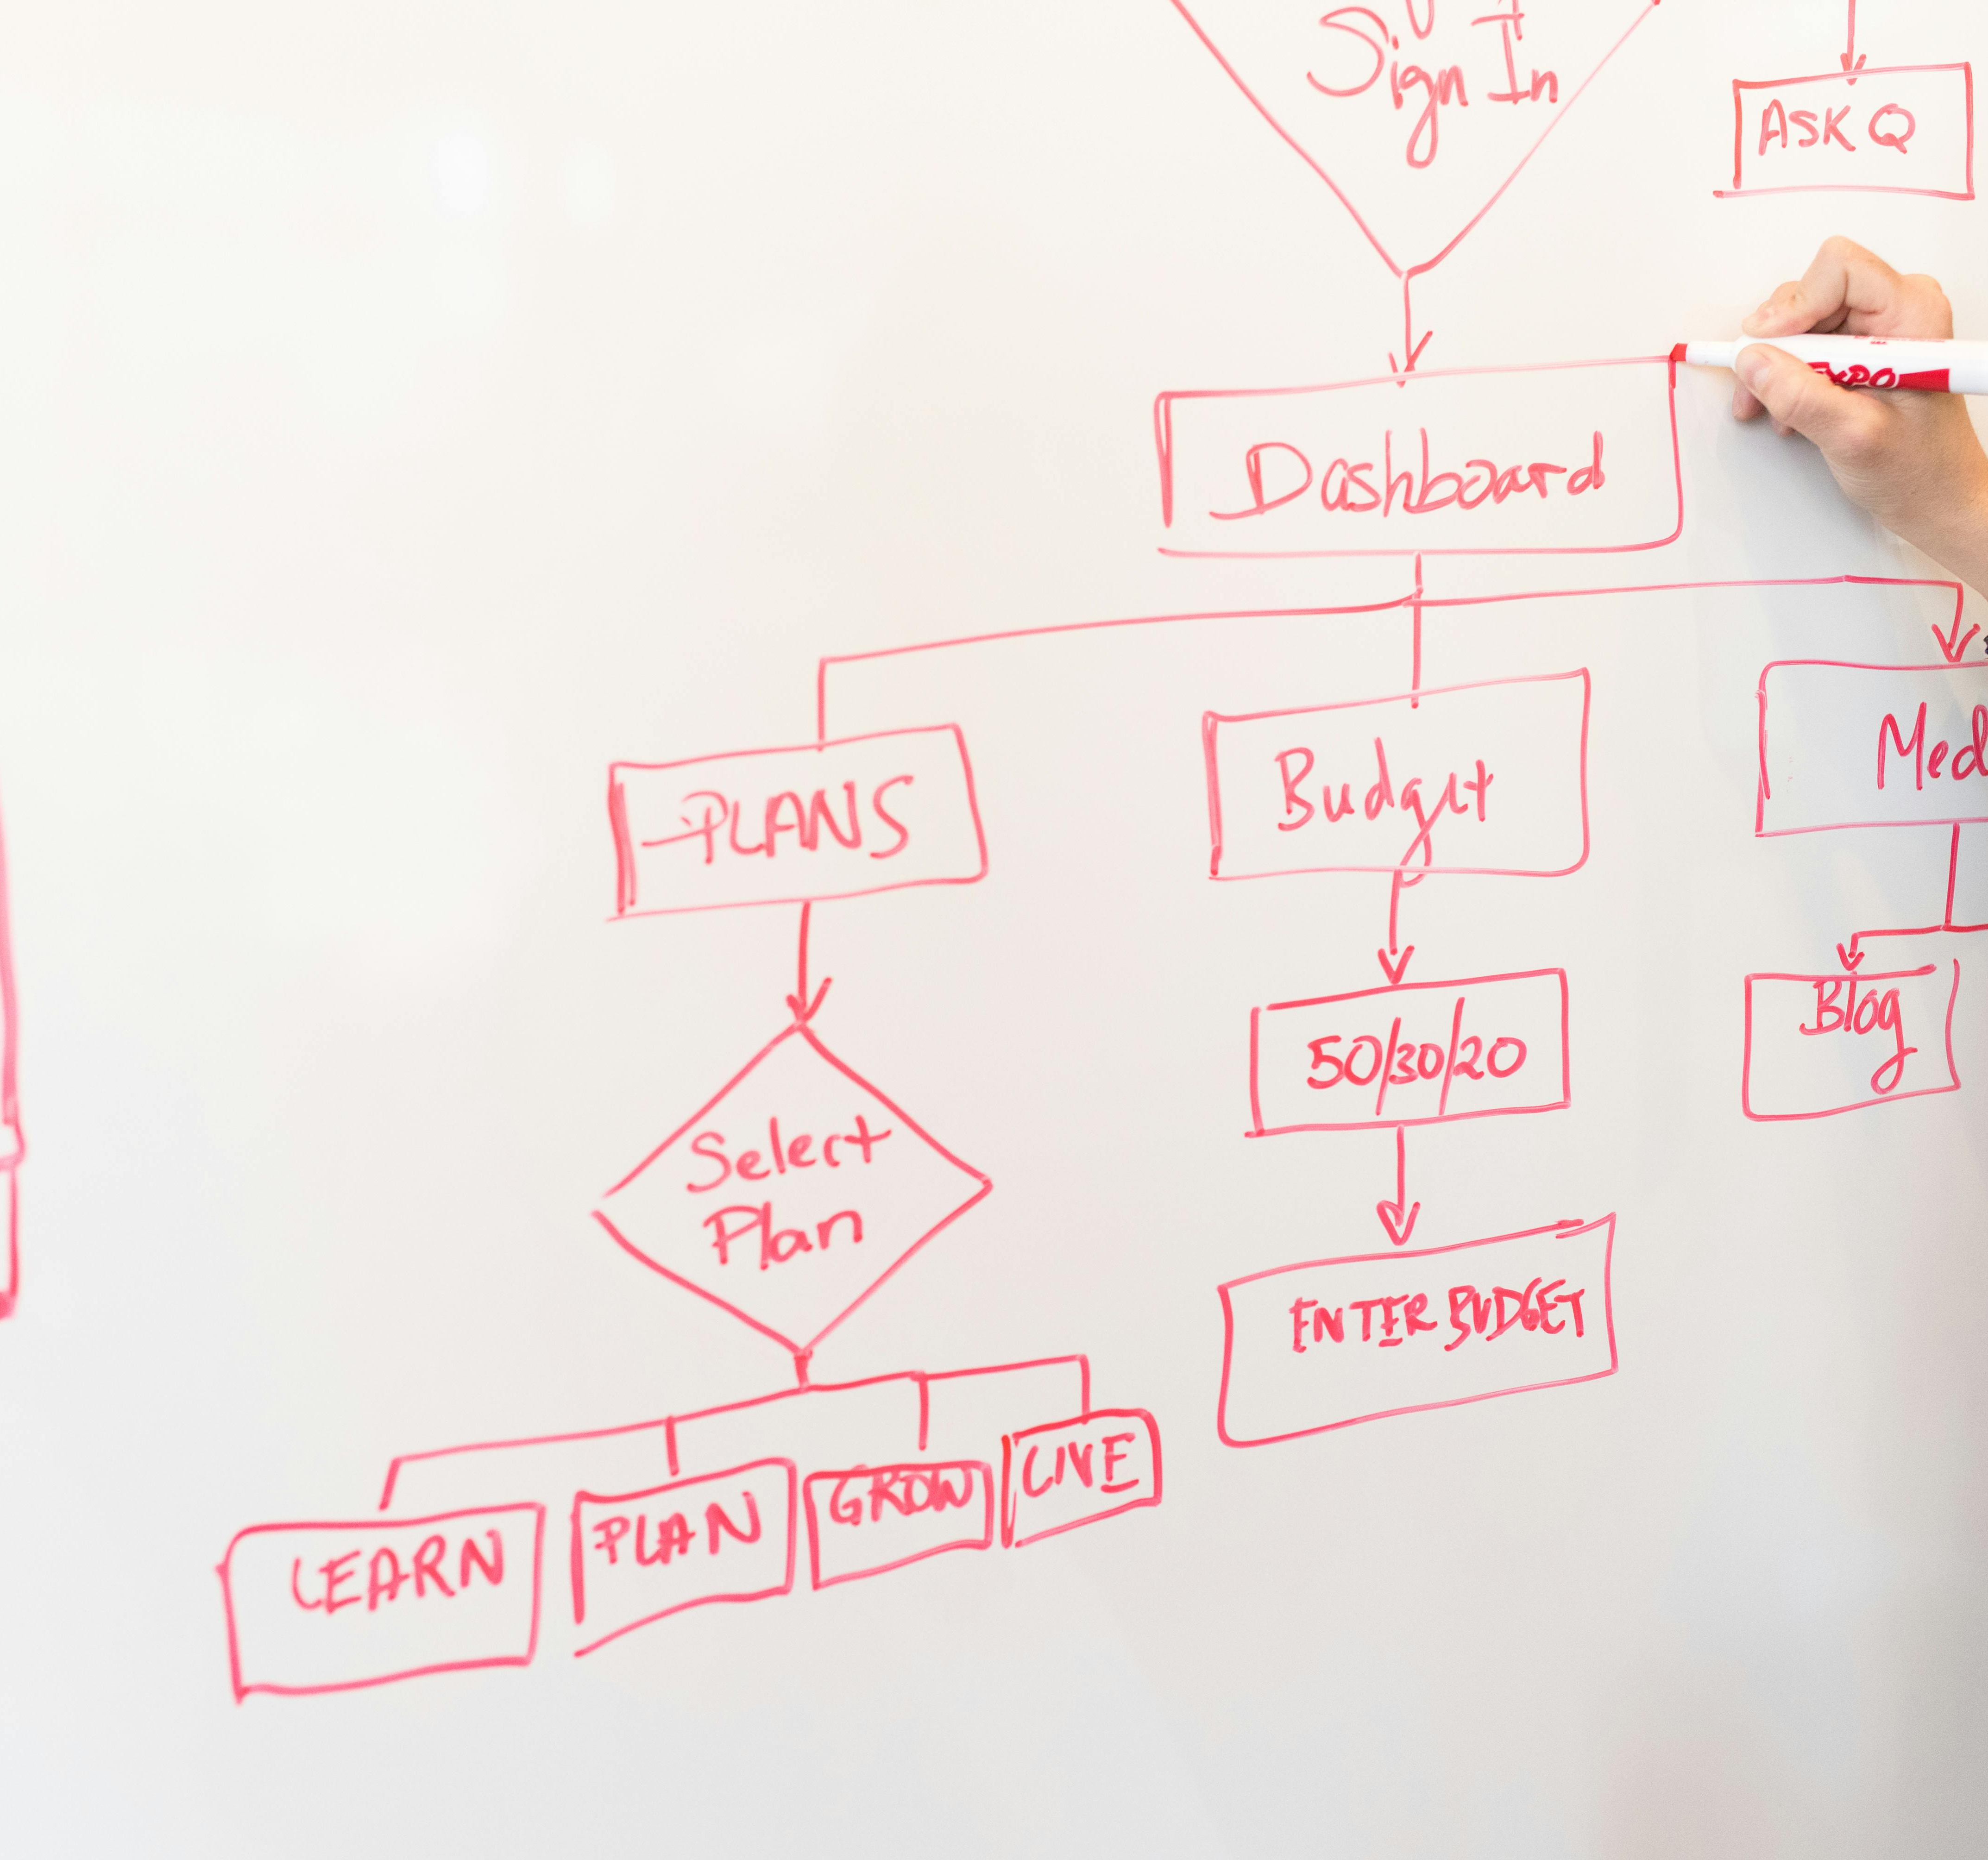
Principles Accounts
Conservative budgeting
Careful record keeping and use of resources
Budget progress reviews 3x per year
Careful choice of conference organisers and locations, with financial reporting 3x per year
Reserve to ensure ongoing viability of HERDSA
The current reserve is $269,351 held in Macquarie Bank

Slide 23

HERDSA Office Accounts Audit
An independent audit by Satendar Kumar from S.K. Accounting and Business Services, NSW has been completed
Copies of the auditor’s report are available on the HERDSA Website:
https://www.herdsa.org.au/AGM-report

Slide 24
Major Income Sources
Description | 2023- 2024 YTD Actuals | 2024- 2025 YTD Actuals | 2025-2026 Projected income
Membership fees | $ 164,324.00 | $ 162,843.00 | $ 165,000.00
Annual conference | $ 52,416.00 | $ 79,816.00 | Unknown at this stage
Annual conference levy 12% | $ 48,620.00 | $ 48,106.00 | $ 40,000.00
HERDSA Guides | $ 2,416.00 | $ 3,440.00 | $1,500.00
HERDSA Journal | $ 116,878.00 | $ 132,919.00 | Unknown at this stage

Slide 25
Key Areas of Expenditure 2024 -2025 and Proposed Budget 2025-2026
Area | 2024-2025 Actuals | 2025-2026 Proposed
Legal and Finance | $ 3,341.00 | $ 4,000.00
Conference | $ 11,480.00 | $ 11,500.00
Sponsorship | $ 600.00 | $ 600.00
Meetings and travel | $ 37,141.00 | $ 62,000.00
Fellowship | $ 1,625.00 | $ 2,000.00
Secretariat (office mgmt. & supplies, rent, equip publicity, phone, software) | $100,946.00 | $ 108,400.00
Life Membership | $ 3,000.00 | None in 2026
ASRHE Journal | $ 6,611.00 | $ 11,000.00
HERD Journal | $106,000.00 | $ 77,573.00
Publications | $ 1,482.00 | $ 3,400.00
HERDSA Website maintenance | $ 4,455.00 | $ 5,000.00
HERDSA Blog | $ 3,510.00 | $ 18,000.00
Notes:
$ 1,500.00
$ 2,000.00

Slide 26
HERDSA Strategic Initiatives (incl new) 2025-2026
Area | 2024-2025 | 2024-2025 YTD Actuals | 2025-2026 Proposed
Conference awards | $25,600.00 | $ 24,700.00 | $ 25,600.00
Research Grants | $35,000.00 | $ 26,815,.00 | $ 50,000.00
Information Technologies | $47,760.00 | $ 26,245.00 $ 21,515.00 cfwd | $ 20.000.00
HERDSA History Project | $12,000.00 | $ 8,000.00 $ 4,000.00 c/fwd | finalised
President Discretionary Fund | $ 5,000.00 | $ 0.00 | $ 5,000.00
HERD Awards | $ 1,500.00 | $ 1,500.00 | $ 1,500.00
Life Membership | $ 3,000.00 | $ 3,000.00 | Next round 2027
SoTL Modules | $ 22,000.00 | $ 10,000.00 $ 12,000.00 cfwd | $ 6,000.00
IT Consultant Project |  | n/a | $ 20,000.00
Business Project | $ 25,000.00 | $ 0.00 | Not required
TOTAL | $176,860.00 | $ 100,260.00 | $128.100.00

Slide 27
Australian Branches Funds held in Trust
June 2024 to31/05/25 | WA | SA | QLD | VIC | ACT | TAS | NSW
Income (+) | $ 0.00 | $ 10,000.00 | $ 2,769.00 | $ 810.00 | $ 0.00 | $ 0.00 | $0.00
Expenses (-) | $ 601.00 | $ 0.00 | $ 5,974.00 | $ 1,590.00 | $ 0.00 | $ 0.00 | $0.00
Closing balances As at 31/5/25 | $7,588.00 | $19,675.00 | $ 7,979.00 | $13,101.00 | $0.00 | $6,574.00 | $0.00

Slide 28
HERDSA Bank Accounts
ACCOUNT | As at 31/5/2024 | As at 31/5/2025
HERDSA Term Deposit Macquarie Bank | $256,969.00 | $269,351.00
Operating account Australia – Commonwealth Bank | $346.781.00 | $556,473.00
Operating account New Zealand | $24,993.00 | $8,330.00

Slide 29
Recommendations for AGM Ratification
That amended HERDSA Constitution (29th June 2017) be ratified. (circulated to members in June 2025)
That the elected 2025-2027 Executive Members be ratified
That Santendra Kumar be appointed as HERDSA auditor for the 2025-2026 year.
That the 2024-2025 budget expenditure be ratified.
2025 – 2026 Strategic Initiatives project expenditure be ratified.
That the 2024-2025 audited accounts be ratified
Copies circulated to members at entry.
Full audited accounts available on HERDSA members website.

Slide 30
HERDSA CONSTITUTION
Please view 4a, 6b and 5b (in Bylaws)
Please view 4a, 6b and 5b (in Bylaws)
Please view 4a, 6b and 5b (in Bylaws)
For AGM Ratification - Clauses 4a, 6b and 5b (in Bylaws)
“In addition, the convenor of the immediate next and subsequent annual conferences will be ex-officio members of the Executive Officers of HERDSA until the conclusion of the respective conferences.” (4a)
“The conference convenor will, for the duration of a period determined by the Executive, be an ex-officio member of the Executive Officer of HERDSA” (6b)
“The conference convenors of the immediate next and subsequent annual HERDSA conferences should be appointed as ex-officio members of the Executive and remain a member of the Executive Officers of HERDSA and remain Officers of HERDSA until the conclusion of the respective conference” (5b)

Slide 31
2025 - 2027 Executive Members Election
For AGM Ratification
Prof Michelle Picard
A/Prof Eva Heinrich
A/Prof Alice Brown
A/Prof Kathie Ardzejewska
Dr Pranit Anand
Dr Tania Leach
Dr Lilia Mantai
Dr Manisha Thakkar
Dr Lee Partridge

Slide 32

Explore Opportunities with HERDSA

Slide 33
Thank You!

