Slide 1
HERDSA
Annual General Meeting
Brisbane Convention & Exhibition Centre
6th July 2023 (12.45pm AEST)

Slide 2
I would like to acknowledge the traditional owners and custodians of the lands where our HERDSA members are located and pay respects to their elders, past, present, and emerging.

Slide 3
AGENDA
Welcome
Attendance and Apologies
Minutes of the previous meeting (for adoption)
President’s Report and Activities
Treasurer’s and Auditor’s Reports
Recommendations for ratification 2023-2024 (incl New Exec, Budget, Auditor, 2022-2023 accounts)
Other business
Meeting closure

Slide 4
HERDSA
President’s Report & Activities
Kogi Naidoo
Brisbane Convention & Exhibition Centre

Slide 5
HERDSA Executive 2021 - 2023
Kogi Naidoo (Vic) President (re-elected 2023-2025)
Deb Clarke (NSW) Vice-President
Elizabeth Levin (Vic) Treasurer
Wendy Green (Tas)
Eva Heinrich (NZ)
Raj Shekhawat (SA)
Katrina Strampel (WA)
Christy Collis (QLD)
Kwong Nui Sim (NSW)
Manisha Thakkar (SA)
Julia Choate (Vic)
Laurine Hurley (Vic)

Slide 6
HERDSA Officers 2021-2023
Wendy Green Executive Editor HERD Journal until Dec 22
Susan Blackley &
Cally Guerin Joint HERD Editors
Maureen Bell Editor HERDSA connect until Jun 23
Lukaz Swiatek Editor HERDSA connect until Dec 22
Eva Heinrich Editor ASRHE Journal
Lee Partridge HERDSA Fellowships
Peter Kandlbinder Editor HERDSA Notices
Denise Chalmers Series Editor HERDSA Guides
Lukazs Swiatek TATAL until Dec 22
Donmei Li TATAL Current
Jennifer Ungaro HERDSA Office Administration Manager

Slide 7
2023 Conference Organising Committee
Our grateful thanks to:
Christy Collis Co Convenor
Kerry Russo Co Convenor
Tania Leach Conference Chair
Malcolm Burt Virtual Program Coordinator
Manisha Thakkar Communications Lead - HERDSA Executive
Raj Shekhawat Liaison Officer - HERDSA Executive
Other associated committees
Expert Events Conference Organiser

Slide 8
Highlights (2022 – 2023, incl. New Initiatives)
HERDSA Strategic Plan 2021-2023 + HERDSA Values (2022)
Celebrating 50 Years of HERDSA (since 1972), History of HERDSA Report
HERDSA Fellowships - 2023 Celebrating 20 years (4 Fellowships)
2022, 2023 Conferences – Melbourne, Brisbane (hybrid) + Online Webinars
HERDSA Conference Travel Grants, Awards and Prizes – 2022, 2023
HERDSA Grants Scheme (2022, 2023) - 10 awards
HERD Best Paper and Reviewer Awards (2022, 2023) – 6 awards
HERDSA Leadership/ Service Awards (2022) – 10 Awards
Life Membership Award 2023 - Professor Shelda Debowski
HERDSA Executive Portfolio Roles & Responsibilities (revised)
2 New Portfolios 2022 – 2023 Events (including Online & Communications)
              Memberships (5 unis have group memberships)

Slide 9
HERDSA VALUES
Connection: We provide opportunities for members to engage in positive, collaborative, scholarly interactions and create conditions conducive to members experiencing a sense of belonging.
Inclusion: We provide a relational and scholarly space in which members are invited to respectfully question, challenge and be informed by a diversity of opinions and perspectives. We are committed to providing access to opportunities and resources to support all our members.
Inquiry: We encourage and support our members to systematically investigate higher education issues, leading to scholarly solutions in practice and policy.
Integrity: We uphold and expect honesty, openness, respect, and trust in members’ interactions with one another and the society.
Quality: Our activities are informed by and contribute to contemporary evidence-based practice to enhance the learning, teaching and research capabilities of our members and their institutions.

Slide 10
Professional Learning Portfolio
2021 - 2023
Katrina Strampel Portfolio Lead
Lee Partridge Fellowships Officer
Deb Clarke New Scholars
Lukazs Swiatek TATAL Officer
Fellowships
2022 2 Fellowships awarded
2023 2 Fellowships awarded
Update:
60 HERDSA Fellows
63 Associate Fellows
16 Assessors on the Board of Assessors

Slide 11
Professional Learning Portfolio
(Continued)
New Scholars
HERDSA SoTL Modules
Review of resources & updating the website
Facilitating online SoTL Module community of practice in universities & HERDSA branches
SOTL Writing Group Workshops
TATAL Group
Pre-conference workshop at 2023 Conference
Webinar 2023
Appointment: TATAL Officer Dongmei Li (current HERDSA Fellow)

Slide 12
Networks Portfolio
Deb Clarke Portfolio Lead
Julia Choate Branches
Kwong Nui Sim HERDSA Events incl online
Christy Collis SIGS
Branches
Nine branches (NSW Branch established in 2022)
Branch Reports are available
HERDSA Webinar series
  Se
HERDSA Events (including online)
HERDSA and ASCILITE
Online Webinars continue

Slide 13
Networks Portfolio (continued)
Special Interest Groups (SIGS)
Assessment Quality – S.Bedford@westernsydney.edu.au & jo.kelder@utas.edu.au
Academic Development – erik.Brogt@canterbury.ac.nz
Health Sciences – skusljic@unimelb.edu.au
Humanities Arts and Social Sciences (HASS) - nira.rahman@unimelb.edu.au
Online Engagement - J.Cohen@latrobe.edu.au & Alice.Brown@usq.edu.au
New SIG enquiries – Christy.collis@usq.edu.au
  e
Liaison with other Societies - Current
ICED, ASCILITE, CAULLT, ACEN, ACUR, HEDx – shared publicity, events, sponsorships, etc.

Slide 14
Publications Portfolio - HERD
Flow of new submissions is increasing…
2017 – 506 submissions
2018 – 738 submissions
2019 – 950 submissions
2020 – 988 submissions
2021 - 1072 submissions
2022 – 1064 submissions
Acceptance for 2021 14.5%
Acceptance for 2022 14%
Average time from submission to 1st decision: 69.9 days

Slide 15
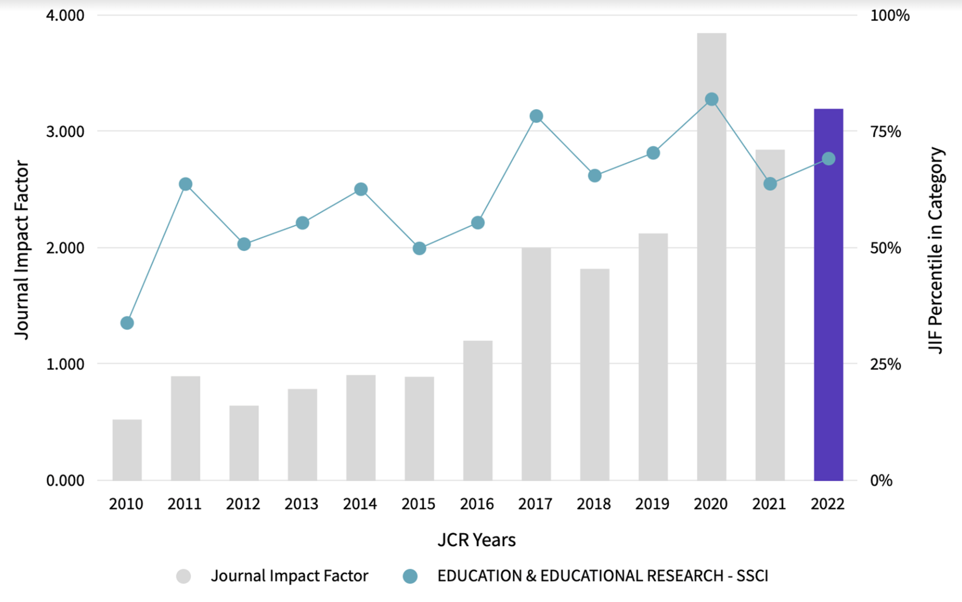
HERD Impact
Journal Impact Factor has risen from 2.849 to 3.23

Slide 16
HERD Editorial Team (Previous & Current)
HERD Editorial Team 2020-2022
Executive Editor Wendy Green
Co-Editors Cally Guerin, Jisun Jung, Ly Tran, Susan Blackley
Special Issues Editor Stephen Marshall
Managing Editor Emily Giles
Social Media Editor Stuart Hughes
HERD Editorial Team 2023-2025
Executive Co-Editors Cally Guerin, Susan Blackley
Co-Editors Neal Dreamson, Jisun Jung, Ly Tran, Rob Wass
Special Issues Editor Stephen Marshall
Managing Editor Emily Giles
Social Media Editor Stuart Hughes

Slide 17
Advancing Scholarship & Research in Higher Education (ASRHE) Journal
Editorial team
Executive Editor Eva Heinrich
Co-editors Geoff Hill, Jo-Anne Kelder, Michelle Picard
Managing Editor Heather Thomas
ASRHE is open source, published under Creative Commons licence
Achievements and updates:
One issue each published in 2021 and 2022
Group-based review and related research development very successful
Still looking for more submissions – marketing campaign underway (HERDSA newsletter and Twitter; initiatives at the conference)

Slide 18
HERDSA Guides Denise Chalmers (Series Editor)
New HERDSA Guide to be released 2023
Enhancing Online Engagement in Higher Education – A Brown, J Lawrence, P Redmond, J Cohen, S M Foote and C Stone
HERDSA Guide released in 2022
Designing Learning in Intensive Modes of Study Gayani Samarawickrema et al. Editor Gail Wilson
23 Guides Available in print and ePublications
ePublications (Kortext)
Purchase Printed or ebooks through the HERDSA website

Slide 19
HERDSA Connect
Update:
3 issues published in 2022 - 2023 (hard copy & available in pdf on website)
Editor Maureen Bell (2022 & 2023)
Co-editor Lukasz Swiatek (2022)
HERDSA Connect status update: Currently in transition

Slide 20
HERDSA Upcoming Conferences
(for noting)
2024 Adelaide, SA 9-11 July 2024
2025 Perth, WA 2025 (date & venue TBC)

Slide 21

HERDSA AGM 2-3 July 2023
Queensland Exhibition & Convention Centre
Treasurer’s Report
Elizabeth Levin

Slide 22
Overview of Accounts
HERDSA Office is located in Sydney, Australia
for the day-to-day operations of the Society, and branch administration of Australian accounts
HERDSA NZ Branch
The HERDSA branch account in NZ is operated by the NZ Branch Treasurer
HERDSA Hong Kong Branch
The HERDSA branch account in HK is operated by the HK Branch Treasurer

Slide 23
Principles
Conservative budgeting
Careful record keeping and use of resources
Budget progress reviews 3x per year
Careful choice of conference organisers and locations, with financial reporting 3x per year
Reserve to ensure ongoing viability of HERDSA
The current reserve is $246,355 held in Macquarie Bank

Slide 24
HERDSA Office Accounts Audit
An independent audit by Satendar Kumar from S.K. Accounting and Business Services, NSW has been completed
Copies of the auditor’s report are available on the HERDSA Website: https://www.herdsa.org.au/AGM-reports

Slide 25
Major Income Sources
Description | 2021- 2022 Actuals | 2022- 2023 Actuals | 2023-2024 Proposed Budget
Membership fees | $109,185.00 | $150,544.00 | $ 130,000.00
Annual conference | Conference cancelled | $ 7,200.00 | TBA
Annual conference levy 12% | Conference cancelled | $42,767.00 | $ 40,000.00
HERDSA Guides | $ 1,267.00 | $2657.00 | $2,000.00
HERDSA Journal | $102,105.00 | $114,351.00 | $100,000.00

Slide 26
Key Areas of Expenditure
and Proposed Budget 2023-2024
Area | 2022-2023 Actuals | 2023-2024 Proposed
Legal and Finance | $ 4,112.00 | $ 4,600.00
Conference | $ 20,535.00 | $ 1,000.00
Sponsorship | $ 682.00 | $ 800.00
Meetings and travel | $ 39,086.00 | $ 62,000.00
Fellowship | $ 1,842.00 | $ 2,000.00
Secretariat | $ 85,310.00 | $ 90,700.00
Life Membership | $ 0.00 | $ 1,200.00
Web Maintenance | $ 11,507.00 | $ 13,600.00
ASRHE Journal | $ 8,990.00 | $ 10,000.00
HERD Journal | $ 78,846.00 | $114,500.00
Publications | $ 35,237.00 | $ 10,000.00

Slide 27
HERDSA Strategic Initiatives (incl new)
2023-2024
Area | 2022-2023 Budget | 2022-2023 Actuals | 2023-2024 Proposed
2023-2024 Conference Awards | $10,500.00 | $10,500.00 | $25,500.00
Information Technologies Project | $ 0.00 | $ 0.00 | $50,000.00
SoTL Modules | $ 2,000.00 | $ 0.00 | $ 2,000.00
Research Grants | $25,000.00 | $24,901.00 | $30,000.00
HERDSA History Project | $20,000.00 | $20,000.00 | $12,000.00
HERDSA MACS Pgm |  |  | $ 0.00
HERDSA Leadership/ Service Awards | $10,000.00 | $10,000.00 | $ 0.00
President Discretionary Fund | $ 5,000.00 | $0.00 | $ 5,000.00
TOTAL |  |  | $124,500.00

Slide 28
Australian Branches
Funds held in Trust
June 2022 to 31/05/23 | WA | SA | QLD | VIC | ACT | TAS | NSW
Income (+) | $ 0.00 | $ 0.00 | $ 0.00 | $10,000.00 | $ 0.00 | $ 0.00 | $0.00
Expenses (-) | $ 295.00 | $ 426.68 | $4928.28 | $ 1425.00 | $ 0.00 | $ 0.00 | $353.00
Closing balances As at 31/5/23 | $9,556.00 | $10,296.00 | $ 1,184.60 | $16,040.00 | $0.00 | $6,574.00 | $0.00

Slide 29
HERDSA BANK ACCOUNTS
ACCOUNT | As at 31/5/2023
HERDSA Funds and branch accounts Bankwest | $ 55,739.00
HERDSA Term Deposit Macquarie Bank | $ 246,355.00
Operating account Australia | $ 220,204.00
Operating account New Zealand | $ 21,727.00

Slide 30
Recommendations for ratification
That Santendra Kumar be appointed as HERDSA auditor for the 2023-2024 year.
That the 2023-2024 budget expenditure be ratified.
2023 – 2024 Strategic Initiatives project expenditure be ratified.
That the 2022-2023 audited accounts be ratified.
Audited accounts available on HERDSA members website.

Slide 31
For Ratification
The HERDSA Executive at its meeting of 2-3 July 2023, recommends the following proposals for ratification:
Life-member: Professor Shelda Debowski
New and co-opted members to the HERDSA Executive 2023-2025

Slide 32
HERDSA Executive 2023 - 2025
Kogi Naidoo (Vic) President (re-elected 2023-2025)
Katrina Strampel (WA) Vice-President
Jay Cohen (Vic) Treasurer (new)
Susan Blackley (QLD) (HERD co-editor)
Eva Heinrich (NZ)
Raj Shekhawat (SA)
Christy Collis (QLD)
Kwong Nui Sim (NSW)
Laurine Hurley (Vic)
Julia Choate (Vic)
Alice Brown (QLD) (new)
Edward Palmer (SA) (Conference Co-convenor 2024)
Manisha Thakkar (SA) Co-option
Lee Partridge (WA) Co-option (new) – Fellowships Officer

Slide 33
Other Business: Agenda items tabled by
Robert Kennelly
Item 1: Would the executive kindly explain to HERDSA members the consultation process it used in making changes to the position of TATAL in the HERDSA structure.
Item 2: Would the executive kindly explain to members:
a. the current state of HERDSA Connect and the executives' plans for the publication in late 2023 and first half 2024, including the role of Editor
b. the consultation process it has used thus far and its intended consultation plans for this same period.

Slide 34
Other Business
Item 1: Would the executive kindly explain to HERDSA members the consultation process it used in making changes to the position of TATAL in the HERDSA structure.
Report back from Exec meeting held on 2-3 July 2023:
The HERDSA Executive revisited its decisions made in March 2023
HERDSA apologises for the perceived lack of consultation regarding changing TATAL from the Professional Learning Portfolio to a Special Interest Group
The decision was reconsidered and subsequently rescinded: TATAL status quo is maintained: TATAL will continue to be located under the Professional Development Portfolio
The Executive ratified the appointment of TATAL Officer, Dongmei Li taking over from Lukasz Swiaktek, and looks forward to working closely with TATAL
Going forward: HERDSA proposes to work with TATAL to develop processes for greater engagement for clearer and timely communications.

Slide 35
Other Business
Item 2. Would the executive kindly explain to members:
a. the current state of HERDSA Connect and the executives' plans for the publication in late 2023 and first half 2024, including the role of Editor
b. the consultation process it has used thus far, and its intended consultation plans for this same period.
HERDSA Executive discussed and the following is planned.
A longstanding deliberation and decision from previous Executives
Plan for 2023 – 2024 (a)
Importance of Connect and acknowledged of the valued contributions of all concerned, particularly, that of Maureen Bell
Transition: HERDSA Connect to HERDSA Connect Blog (Aug)
EOI on HERDSA Notices for HERDSA Connect Blog editor
Consultation to date: HERDSA Conference attendees responded to the post-conference survey (2022), Input to questions and data was shared with Connect editors
Further consultation with HERDSA membership: Survey (Sept)

Slide 36
Closing
Thank you!

Slide 37
HERDSA Executive Meeting
2-3 July 2023
Currently 5 Universities have taken up Group Memberships
UWA, ECU, Deakin, Auckland, SA
HERDSA Group Membership
Group Membership 1 year | 10 members $1435 ($1650) | 20 Members $2870 ($3300) | 30 Members $4260 ($4950)
Other Benefits | 1 free pre-conference workshop 1 free Associate Fellowship application ($110) | 2 free pre-conference workshops 2 free Associate Fellowship applications ($220) | 3 free pre-conference workshops 3 free Associate Fellowship applications ($330)

